Slide 1
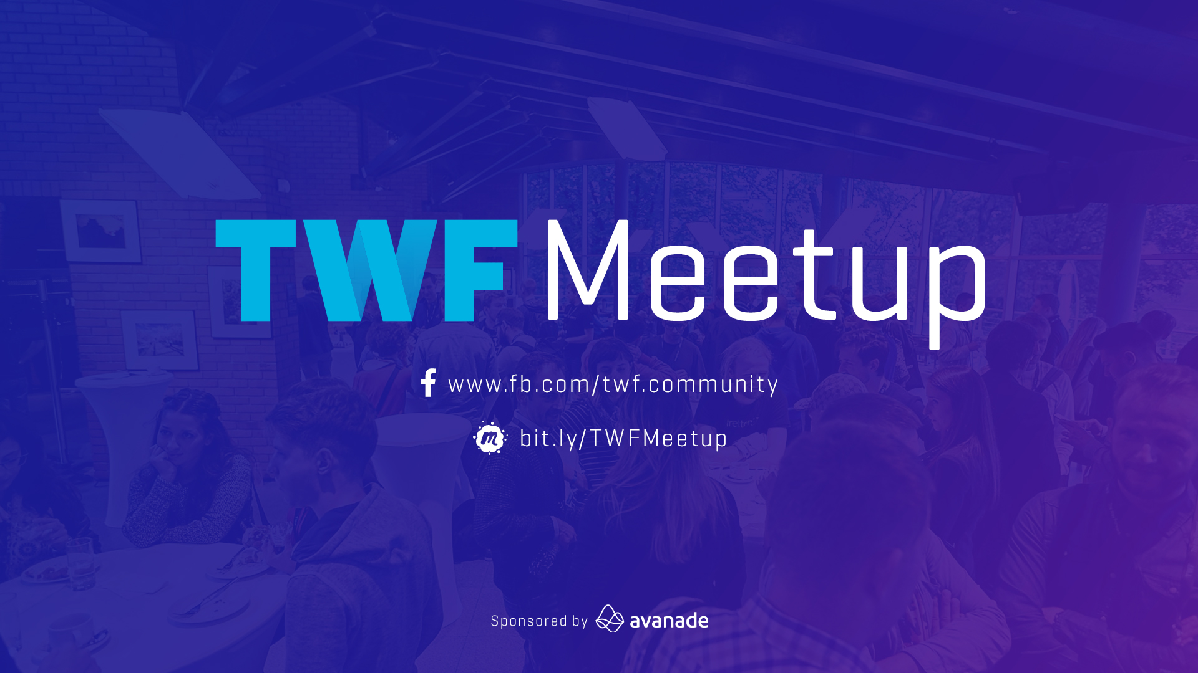

Slide 2
Functional Programming from Zero to Not-Zero!

Slide 3



Youenn Bouglouan
@Work
C#, F#
Software Architecture(s)
Product Management
@Home
Elm, Elixir
Actor Model / Akka.NET
And recently... React/Redux with TS
@YouennBouglouan Blog www.ybouglouan.pl

Slide 4
Why today’s presentation?

Slide 5

Excuse me Sir, could you spare a moment to talk about Functional Programming, our Lord and Saviour?

Slide 6

DO I NEED MATHS FOR THIS TALK!?

Slide 7
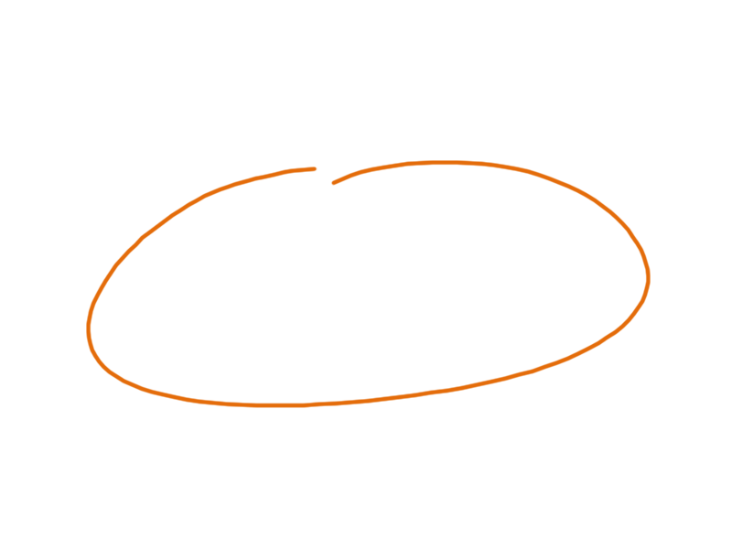
This talk won’t be about Type Systems*!
Warning!
Sum Types
Pattern Matching
Higher Kinded Types
Immutability
Option
Advanced Type Inference
Type Classes
Result
Structural Subtyping
FP Languages
Rust, Kotlin, TypeScript...
*Want to learn more about Type Systems? Check out this presentation https://youenn-bouglouan.github.io/DoYouEvenType

Slide 8
Functional Programming in the wild

Slide 9
„FP is nice for academic research, but for real, complex projects OOP is the only way.”
„Testimonials”
„FP is slow and inefficient, you can’t really use it for anything serious”
„FP doesn’t make any sense because there are no semicolons or brackets”

Slide 10

Rules Engine for their multiplayer games in F#
700k players and 150m requests / day
source

Slide 11

Online learning platform in Elm
Used by 50% of School Districts in the US
source

Slide 12

Wireless Railway & Fleet monitoring in F#
10 billion events processed without a single failure
source

Slide 13

Voice & text chat platform in Elixir
Handle 5 million concurrent users!
source

Slide 14

Web Services & Internal APIs in F#
6000+ Online courses

Slide 15

Notifications system & Ads API in Elixir
150+M users monthly, 175B items 10x smaller codebase, 2x less servers
source

Slide 16

700+ microservices in F#
From 0 to 8M users in 1,5 years Acquired by Walmart for $3.3B!
source

Slide 17

Server implementation in Erlang
Most popular message broker 35+k applications relying on it
source

Slide 18

Infrastructure in Erlang
Acquired by Facebook for $19B Only 50 engineers to support 900M users!
source

Slide 19

And hundreds of others!
“Once upon a time, Cisco, Ericsson, Goldman Sachs, WhatsApp, Amazon and many other top companies kept a secret. Erlang was that badly kept secret.”
source

Slide 20
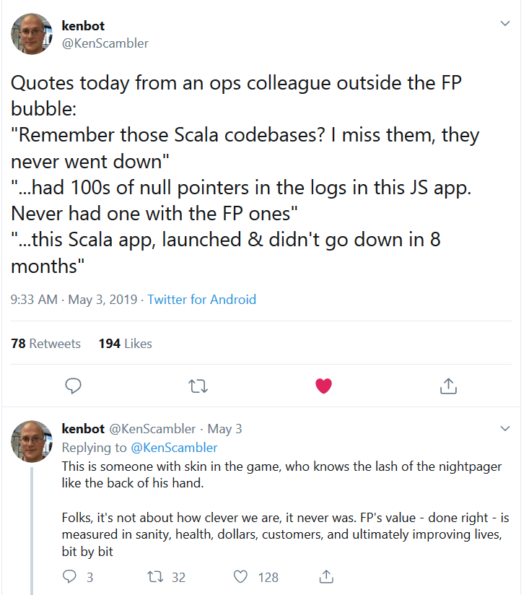
It’s not only about the programmers…
source

Slide 21
Data Science / Big Data
Boring Line of Business Apps (BLOBAs)
REST APIs / Microservices
Web UIs / Mobile Apps
Domain Modelling / Event Sourcing
Distributed, Fault tolerant systems

Slide 22

Decision tree: Can I use FP in my App?
Does your program manipulate data?
Yes
No
You can use FP
Your program is useless

Slide 23
When is FP not a good choice
Demanding 3D games
…?

Slide 24
What’s Functional Programming?

Slide 25
public interface IDoStuff { string DoStuff(int i, bool b); bool DoCoolStuff(string s); }

Slide 26
public interface IDoStuff { string DoStuff(int i, bool b); bool DoCoolStuff(string s); }
*Legend important names
not-so-important names
types stuff and fluff

Slide 27
public interface IDoStuff { string DoStuff(int i, bool b); bool DoCoolStuff(string s); }

Slide 28
public interface IDoStuff { string DoStuff(int i, bool b); bool DoCoolStuff(string s); }

Slide 29
public interface IDoStuff { string DoStuff(int i, bool b); bool DoCoolStuff(string s); }

Slide 30
public interface IDoStuff { string DoStuff(int i, bool b); bool DoCoolStuff(string s); }

Slide 31
public interface IDoStuff { string DoStuff(int i, bool b) bool DoCoolStuff(string s) }
SOLID to the rescue!

Slide 32
IDoStuff { string DoStuff(int i, bool b) } IDoCoolStuff { bool DoCoolStuff(string s) }

Slide 33
IDoStuff { string DoStuff(int i, bool b) } IDoCoolStuff { bool DoCoolStuff(string s) }

Slide 34
string DoStuff(int i, bool b) bool DoCoolStuff(string s)

Slide 35
public interface IDoStuff { string DoStuff(int i, bool b); bool DoCoolStuff(string s); }
Before
string DoStuff(int i, bool b) bool DoCoolStuff(string s)
After

Slide 36
string DoStuff(int i, bool b) bool DoCoolStuff(string s)

Slide 37

string DoStuff(int, bool) bool DoCoolStuff(string)
Our simplified interface
A function signature
Another function signature!

Slide 38
string DoStuff(int, bool) bool DoCoolStuff(string)
Function signatures are the ultimate interfaces!

Slide 39
DoStuff: int -> bool -> string DoCoolStuff: string -> bool
Alternative syntax

Slide 40
DoStuff: int -> bool -> string DoStuff takes an int and a bool and returns a string

Slide 41
type DoStuff = int -> bool -> string type DoCoolStuff = string -> bool
in F#
A function type

Slide 42
typealias DoStuff = (int, bool) -> string typealias DoCoolStuff = (string) -> bool
in Kotlin!

Slide 43
in F#
type DoStuff = int -> bool -> string let DoMyStuff: DoStuff = // ... TODO
The implementation must respect the contract

Slide 44
type Customer = { Age: int; Code: string } type CustomerId = int type GetCustomer = CustomerId -> Customer
in F#
An F# record
An F# alias
An F# function type

Slide 45
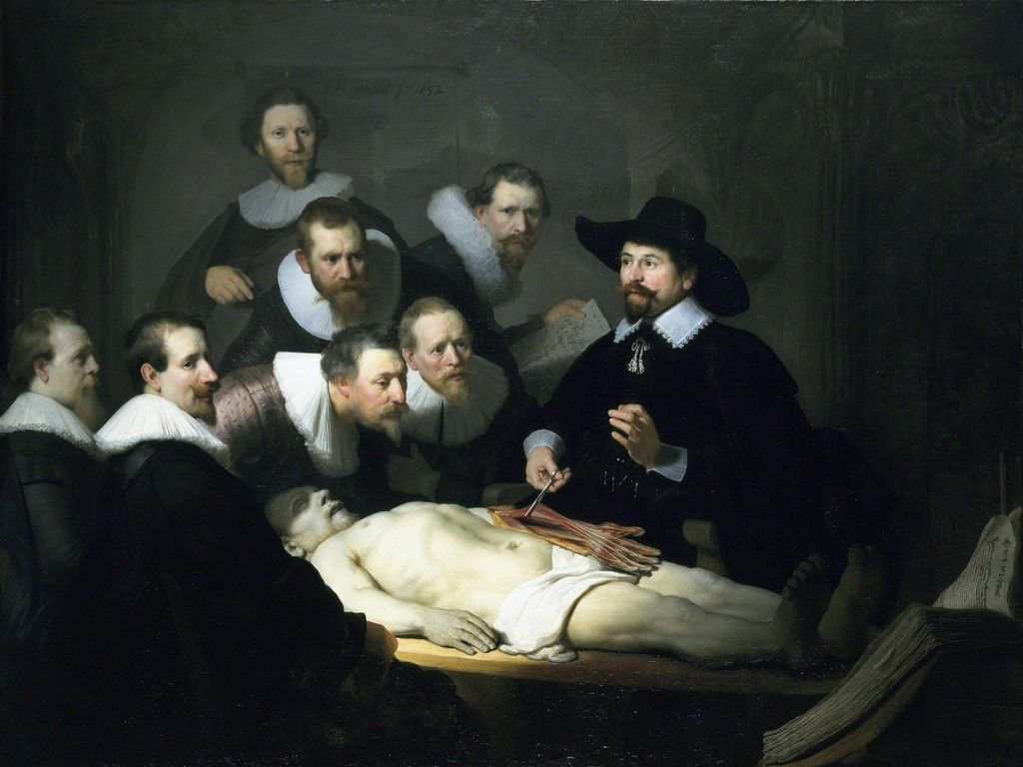
Anatomy of a function
source
(in F#)

Slide 46
let add a b = a + b
A simple example...
The function name
input
output

Slide 47
let add a b = let result = a + b result
With a local variable to store the output
In F#, the last statement is automatically returned

Slide 48
let add (a: int) (b : int) : int = let result: int = a + b result
With explicit type annotations...

Slide 49
let add a b = a + b
Simpler is better!

Slide 50
type Customer = { Age: int; Code: string } type CustomerId = int type GetCustomer = CustomerId -> Customer
Back to our GetCustomer example

Slide 51
let getCustomer: GetCustomer = fun customerId -> { Age = 32; Code = customerId |> string } let customer = getCustomer 123
Implement the contract explicitly
It’s a type!

Slide 52
let getCustomer customerId = { Age = 32; Code = customerId |> string }
Which is equivalent to...

Slide 53

let print func x = printfn "%i" (func x) let double x = x + x let square x = x * x print double 3 // prints "6" print square 3 // prints "9"
A word about Higher-Order functions
A function passed to a function!

Slide 54

var oldEmployees = employees .Where(x => x.Age > 32);
LinQ anyone?
a function
a Higher-Order function

Slide 55

In Functional Programming... functions stand on their own
No classes! No interfaces! No fluff!
Clear separation between data and behaviour
Functions are first-class citizens!

Slide 56
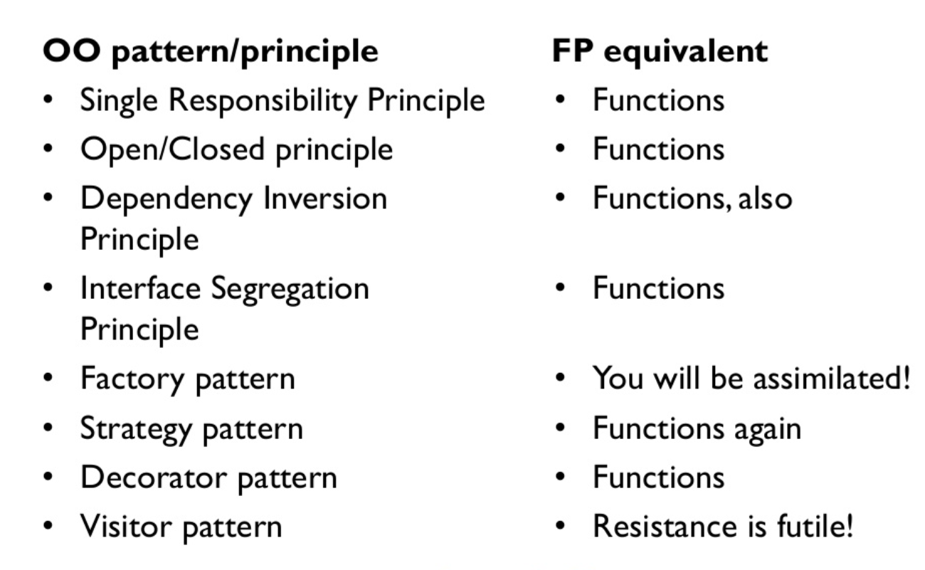

BTW, check out Scott Wlaschin’s blog at fsharpforfunandprofit.com
source

Slide 57
Let’s talk about functions

Slide 58
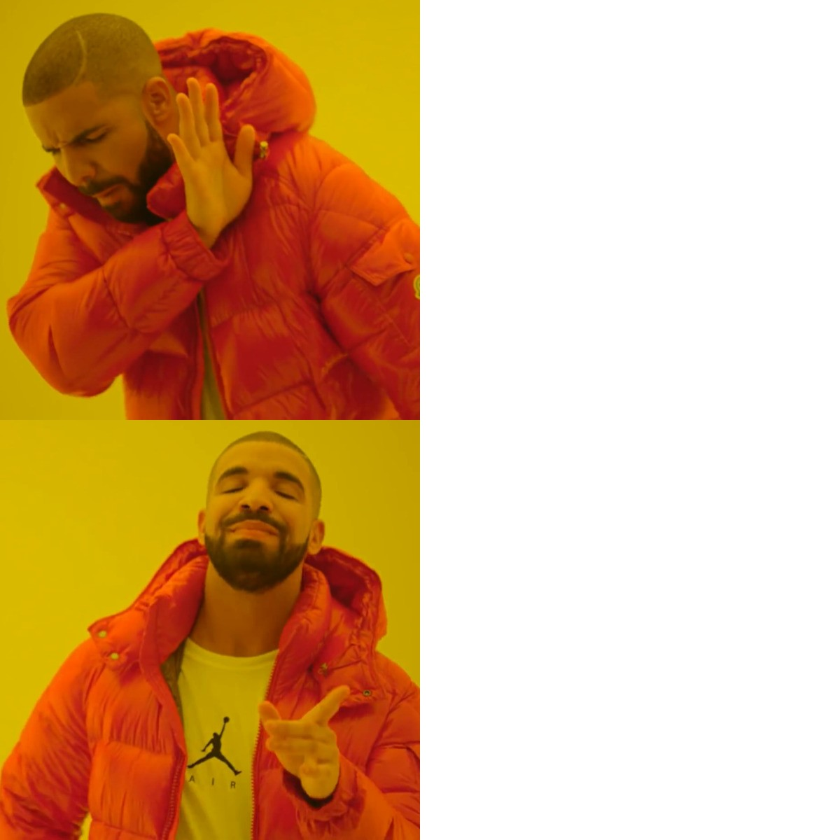
Impure functions
Pure functions

Slide 59
A function is pure if and only if ... it produces an output solely based on its input(s) ... it does not perform any side effect
Pure functions

Slide 60

Examples of pure functions
// int -> int -> int let add a b = a + b
// string -> string let toUpper (str: string) = str.ToUpper ()
// string -> string -> int -> Customer
let createCustomer fname lname age =
{ Code = fname + lname |> toUpper
Age = age }
A new F# Customer record

Slide 61
A pure function ... is trivial to test* ... can be easily optimized**
Benefits?
* You can even generate tests automatically (see Property-Based Testing)
** It can safely be cached (memoization), parallelized, or lazy-evaluated

Slide 62
Quiz: Is this function pure?
// DateTime -> int let getElapsedTime date =
(DateTime.UtcNow- date).Days
No! DateTime.UtcNow is not deterministic

Slide 63
Let’s fix it!
// DateTime -> DateTime -> int let getElapsedTime date reference =
(reference - date).Days
the time reference is now an input of the function

Slide 64
A function is impure if it performs any side effect, like ... Mutating its input or a global variable ... Performing some IO operation
Impure functions

Slide 65
Issue 1: Mutating the function’s input
// Customer -> int -> unit let updateCustomerAge customer age =
customer.Age <- age
Uh oh! What if customer is being shared between threads or being cached?

Slide 66

Issue 1: Solution
Make customer immutable
// Customer -> int -> Customer let updateCustomerAge customer age =
{ customer with Age = age }
And return a new instance

Slide 67

Issue 2: Changing the global state
BTW mutability must be expressed explicitly
Let mutable Count = 0
// Customer list-> unit let updateCount customers = Count <- List.length customers
Count is not in the input, it is global

Slide 68
Issue 2: Solution
Compute and return the value
// Customer list-> int let countCustomers customers = List.length customers
let Count = countCustomers customers
And assign the value outside the function

Slide 69

Issue 3: Performing IO
Write IO
// unit -> unit let showReport () =
let report = createReport Filename UserId
printConsole report
// string -> int -> Report let createReport filename userId =
let data = readFile filename let user = getUserFromDB userId let report = processData data user
report
Read IO
Not trivial to test!
Pure logic

Slide 70
Issue 3: Solution??
There’s no simple solution, right? RIGHT?

Slide 71
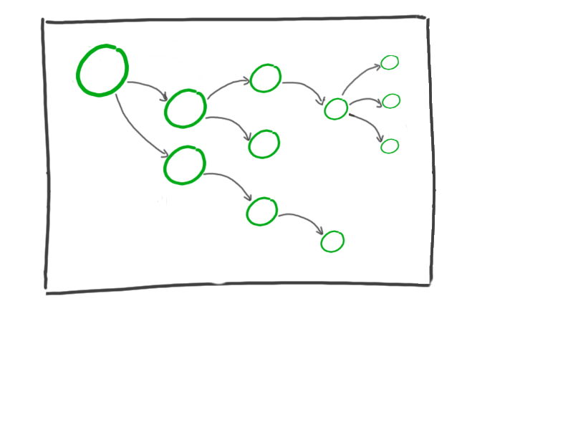
The problem with Side Effects
A pure program!

Slide 72
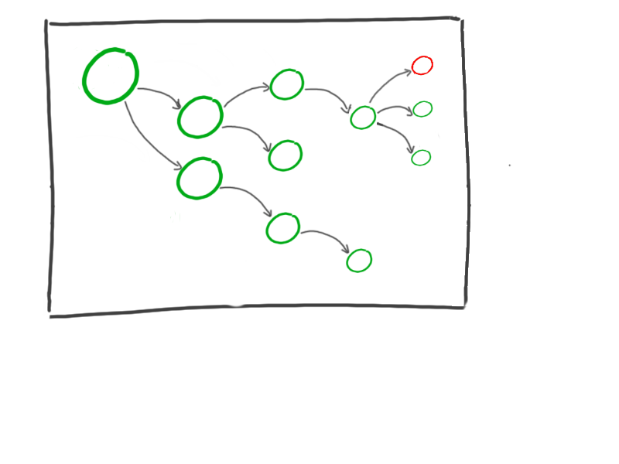
The problem with Side Effects
A side effect

Slide 73

The problem with Side Effects
Uh oh...

Slide 74

The problem with Side Effects
Uh oh... Impurity

Slide 75
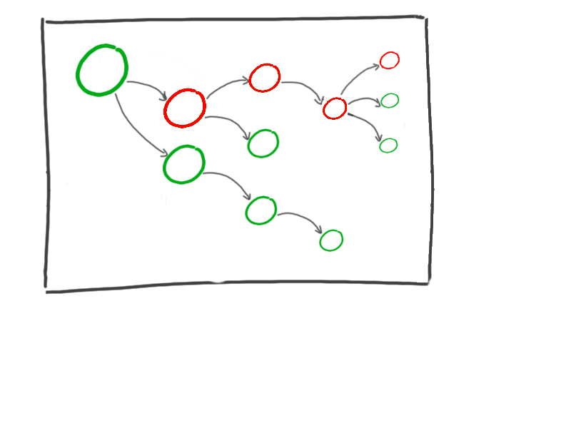
The problem with Side Effects
Uh oh... Impurity is

Slide 76
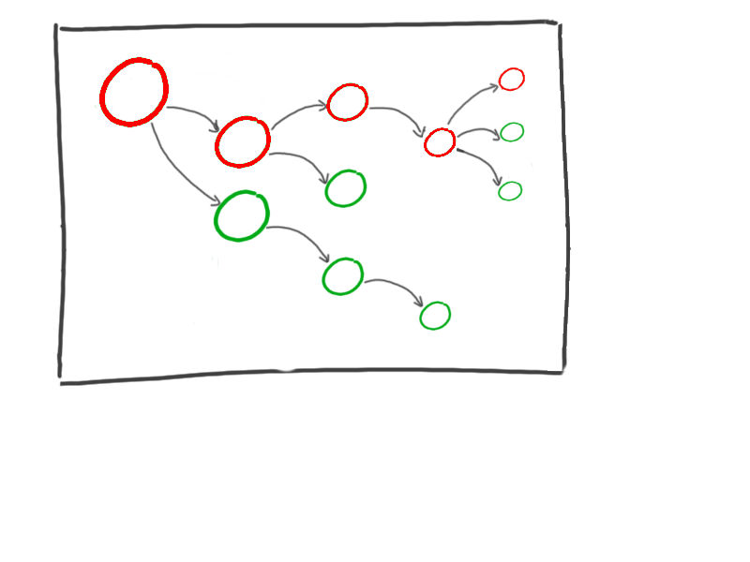
The problem with Side Effects
Uh oh... Impurity is contagious!

Slide 77
The problem with Side Effects
How to fix this?

Slide 78
The problem with Side Effects
Move this guy...

Slide 79
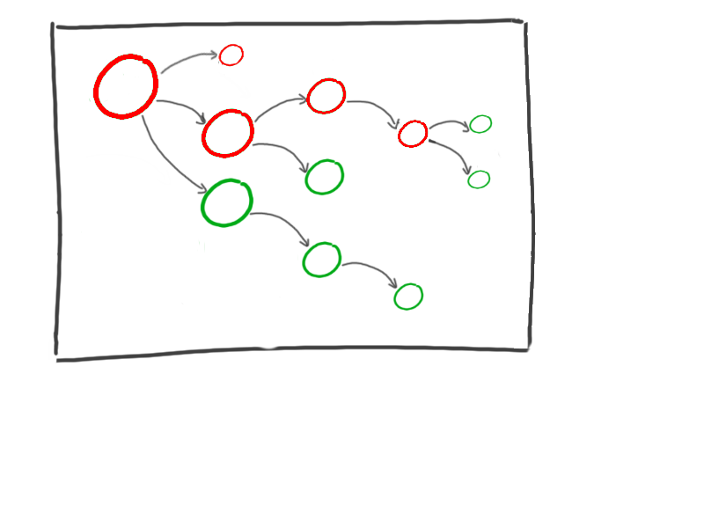
The problem with Side Effects
Here!

Slide 80
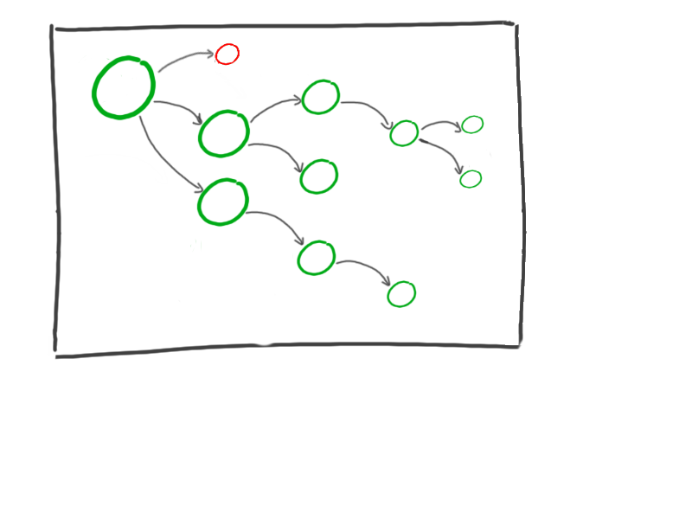


The problem with Side Effects
This branch is pure again!

Slide 81


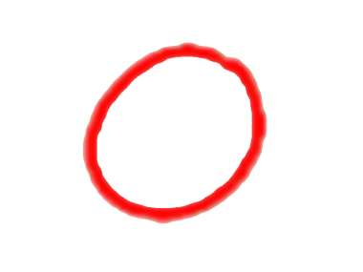
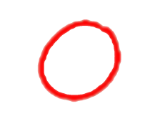

The Impure/Pure/Impure Sandwich
Impure
slice
Pure
filling
Impure
slice
A big ball of mud
A nice sandwich
source

Slide 82
Functional Core, Imperative Shell
Functional Core
Imperative Shell
source

Slide 83
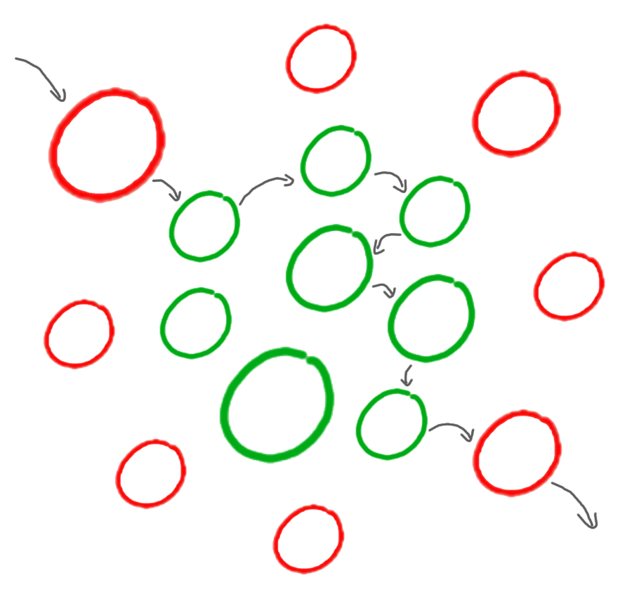
Functional Core, Imperative Shell
Create Report
DB
SMTP
Send Report by Email

Slide 84
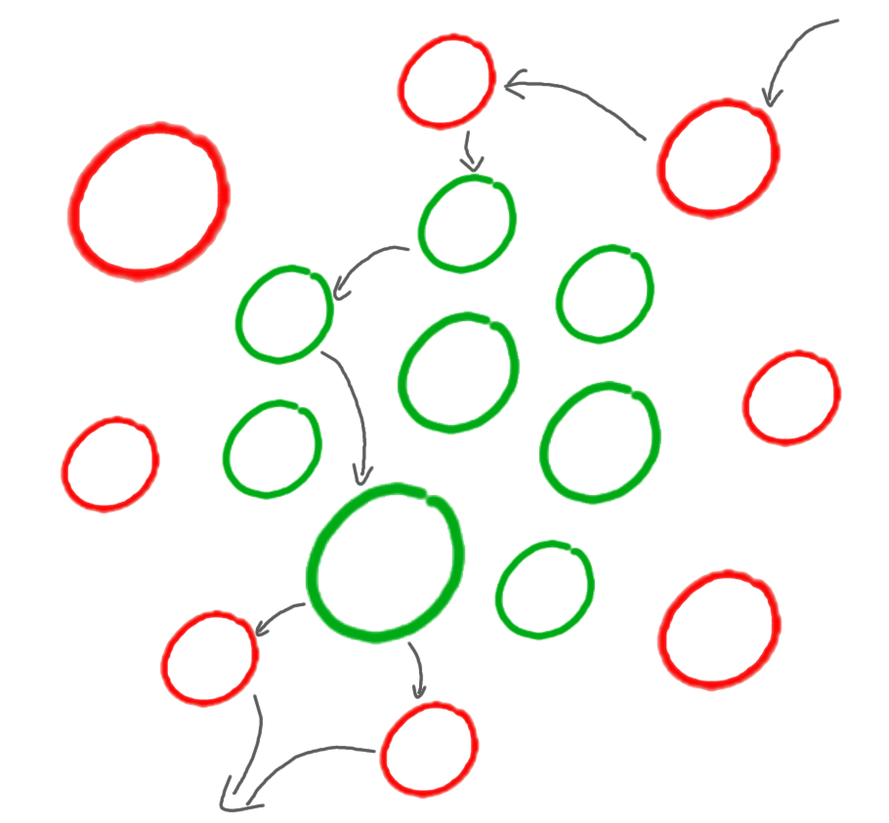
Functional Core, Imperative Shell
Redis
Update Invoice
HTTP/REST
DB
Message Queue
Notify –
Invoice Updated

Slide 85
Going back to our original example...
// unit -> unit let showReport () =
let report = createReport Filename UserId
printConsole report
// string -> int -> Report let createReport filename userId =
let data = readFile filename let user = getUserFromDB userId let report = processData data user
report

Slide 86

After applying our IO sandwich
All IO moved to the top
// unit -> unit let showReport () = let data = readFile filename let user = getUserFromDB userId
let report = createReport data user
printConsole report
// ReportData -> User -> Report let createReport data user = let report = processData data user
report
createReport is now pure (and easily testable)!

Slide 87

Pro-tip: Identifying Side Effects
Functions that return unit (void) usually perform a side effect
// Customer -> unit let saveCustomer customer = Db.Save customer
If you see those in the middle of your logic, then you’re probably doing something wrong!

Slide 88
… by isolating side effects from the rest of the codebase
In Functional Programming... We control Side Effects explicitly
… by maximizing the pure-to-impure ratio in our application

Slide 89
Functional programming, or how to truly reuse stuff

Slide 90
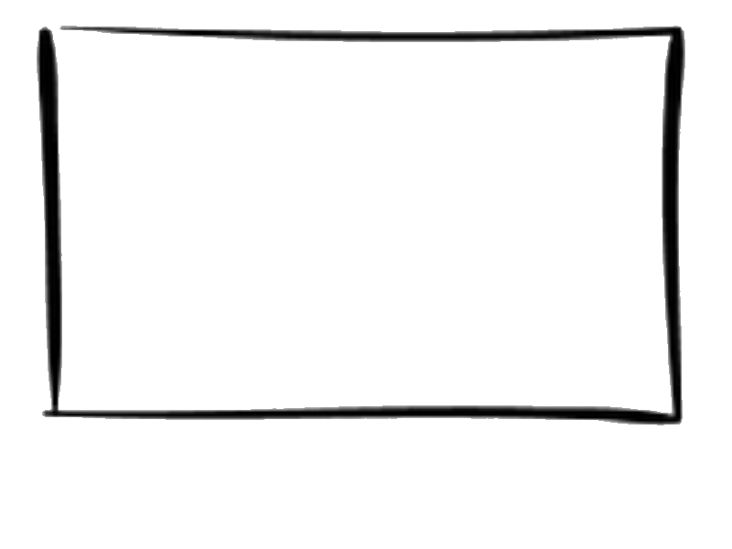













In the OO World…
InvoicesService class
UsersService class
Bags of functions?
ProductsService class

Slide 91
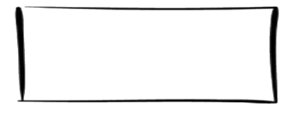

In the OO World…
UsersService class
Implicit dependencies!

Slide 92
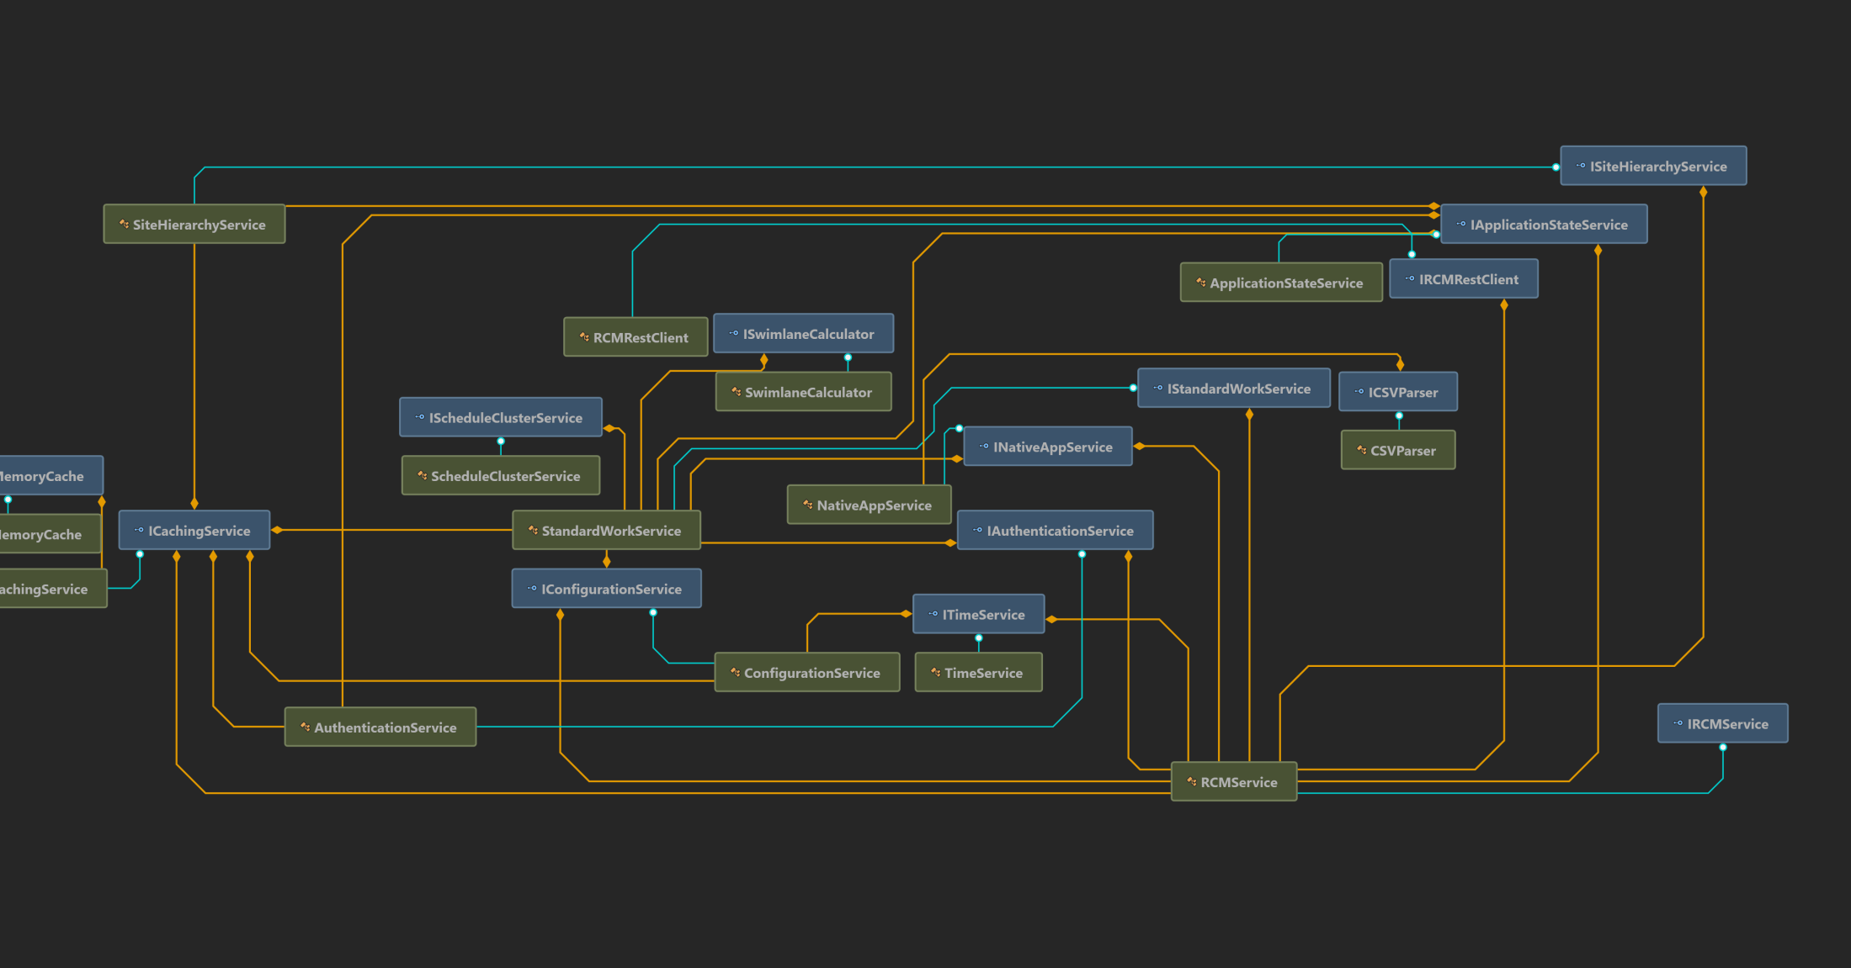
In the OO World…

Slide 93
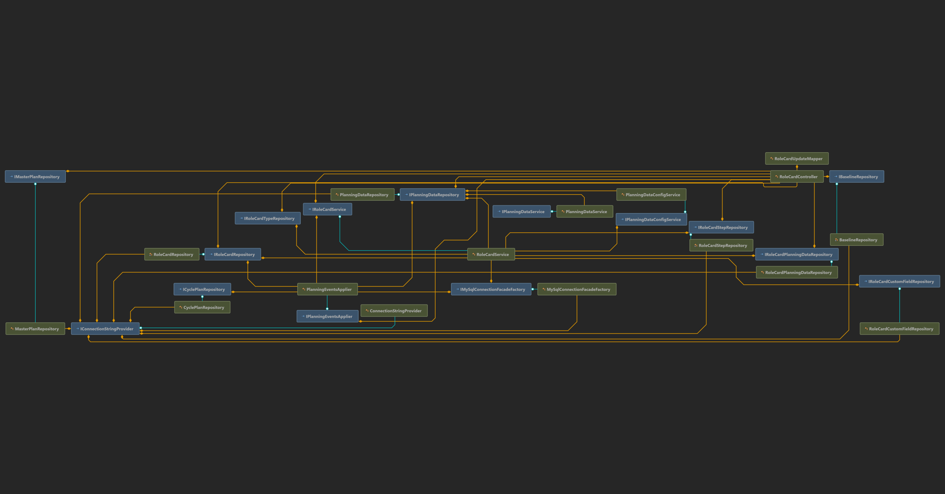
In the OO World…

Slide 94

What does it mean in practice?
… could break your logic here!
A slight change in a method here…
The high coupling makes reusability difficult

Slide 95
In the FP World…
A true bag of functions!
No strings attached

Slide 96
In the FP World…
Workflow 1
We create workflows by composing functions together
Workflow 2

Slide 97
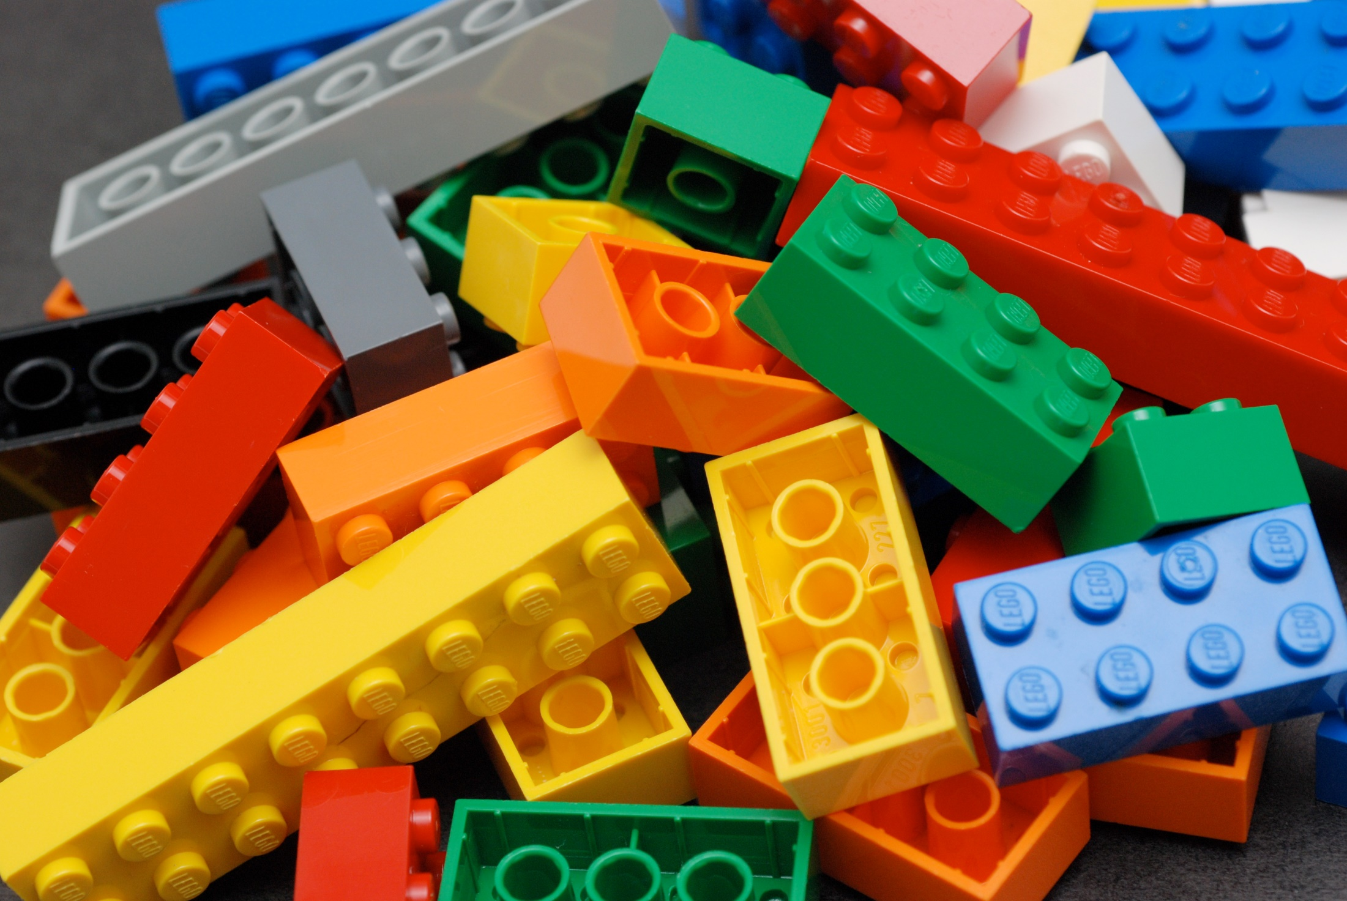
How does function composition work?

Slide 98
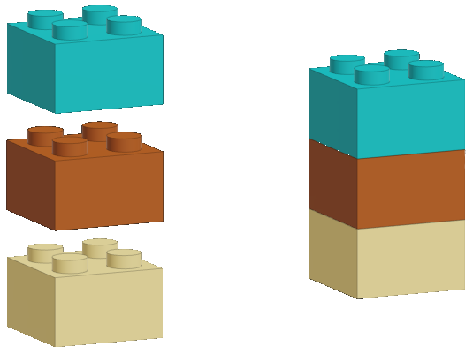
How does function composition work?

Slide 99
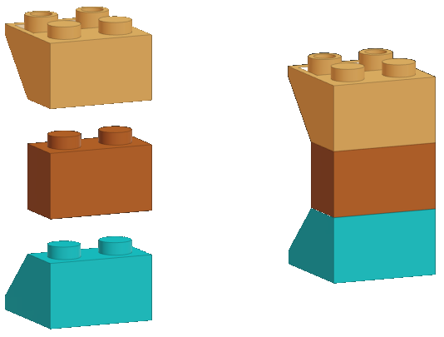
How does function composition work?

Slide 100
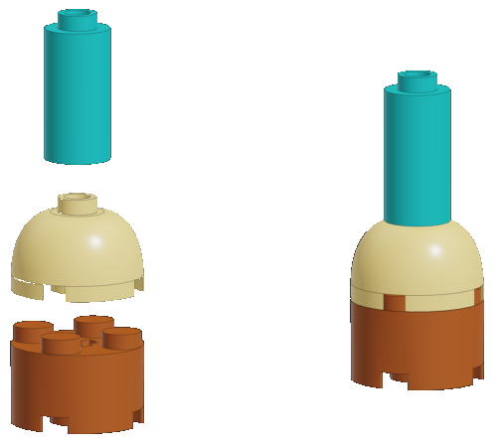
How does function composition work?

Slide 101
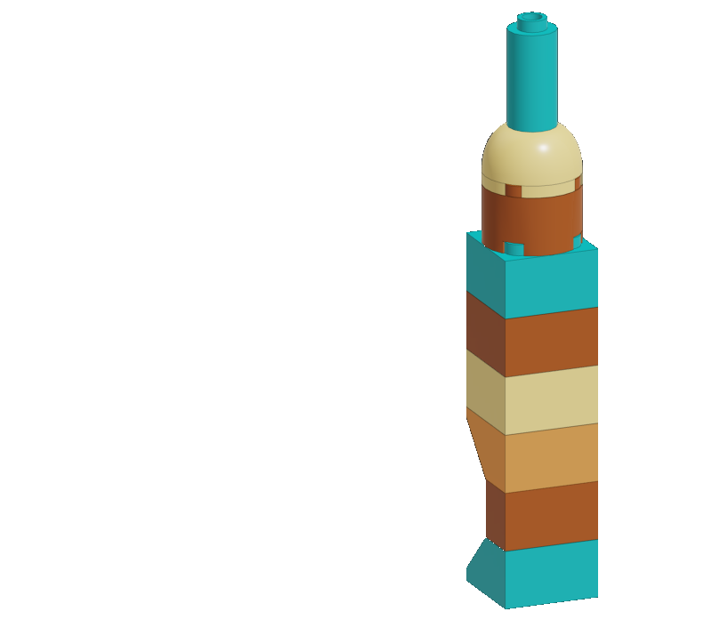
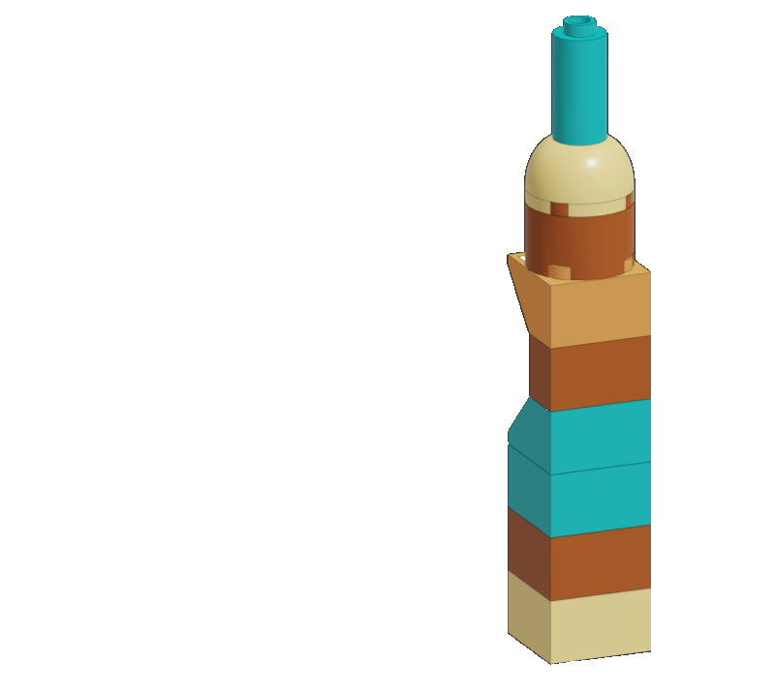
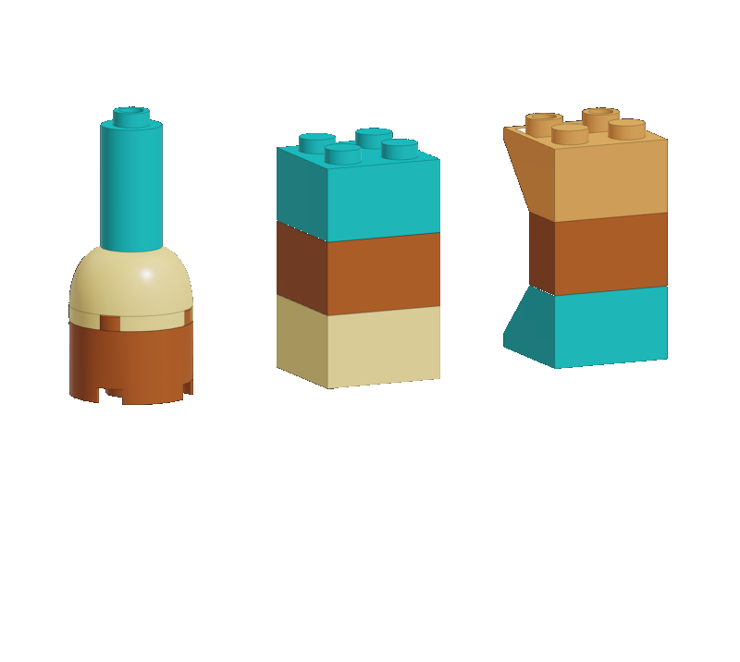
How does function composition work?

Slide 102
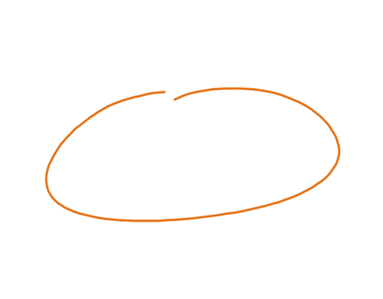
Composing functions with |> (Pipe)
// Item list -> Order let takeOrder items = ...
// Order -> Package let prepareOrder order = ...
// Address -> Package -> Delivery let deliver address package = ...
let delivery = [ „Shoes”; „Glasses” ] |> takeOrder |> prepareOrder |> deliver „Kraków”
The data source
Reads like English
*The pipe operator is explained in details on my blog

Slide 103
Composing functions with >>
// Item list -> Order let takeOrder items = ...
// Order -> Package let prepareOrder order = ...
// Address -> Package -> Delivery let deliver address package = ...
// Item list -> Delivery
let orderItems addr =
takeOrder >> prepareOrder >> (deliver addr)
let delivery =
orderItems „Kraków” [ „Shoes”; „Glasses” ]
composition operator

Slide 104
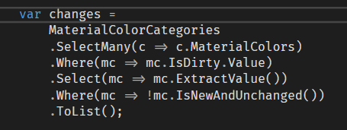
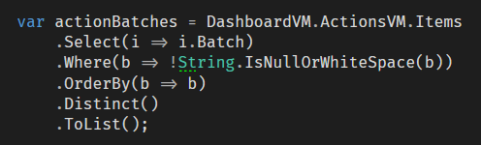
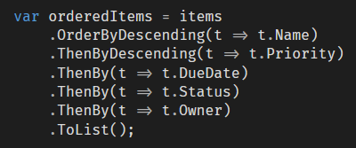
Examples of composition in C#

Slide 105
HTTP PUT /api/orders
But… Where do I compose?
Our programs are full of
mini, functional composition roots!
Confirm Order
let delivery = [ „Shoes”; „Glasses” ] |> takeOrder |> prepareOrder |> deliver „Kraków”

Slide 106
… we create programs by composing small building blocks together
In Functional Programming... Your logic is truly reusable
… we use higher order functions to make our programs more generic

Slide 107
Functional Frontend Architectures

Slide 108
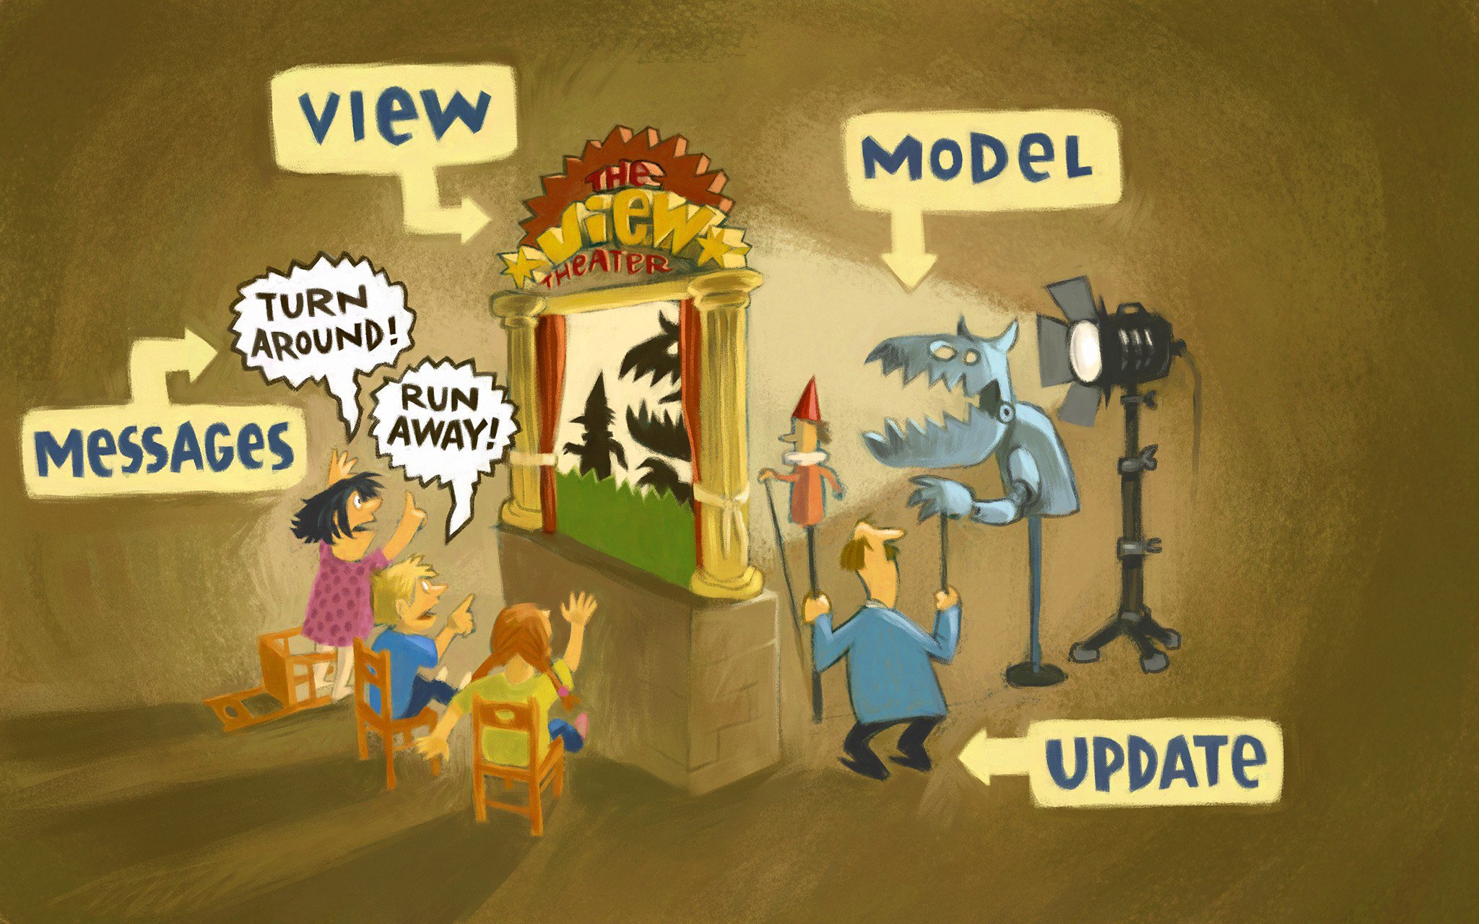
The Elm Architecture - MVU
source

Slide 109
Model: State of your app (immutable) View: Pure function that renders the State as HTML Update: Pure function that updates the State (by returning a new State!)
Elm in a nutshell
The Elm Architecture - MVU

Slide 110

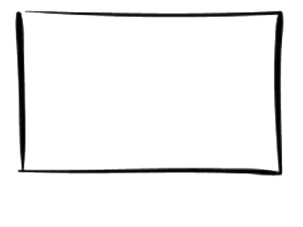
Model
Create a new model!
Update
View
MSG
+ MODEL
HTML
Elm Runtime
HTTP
JS PORTS
DOM
*
*
*
The Elm Architecture - MVU

Slide 111
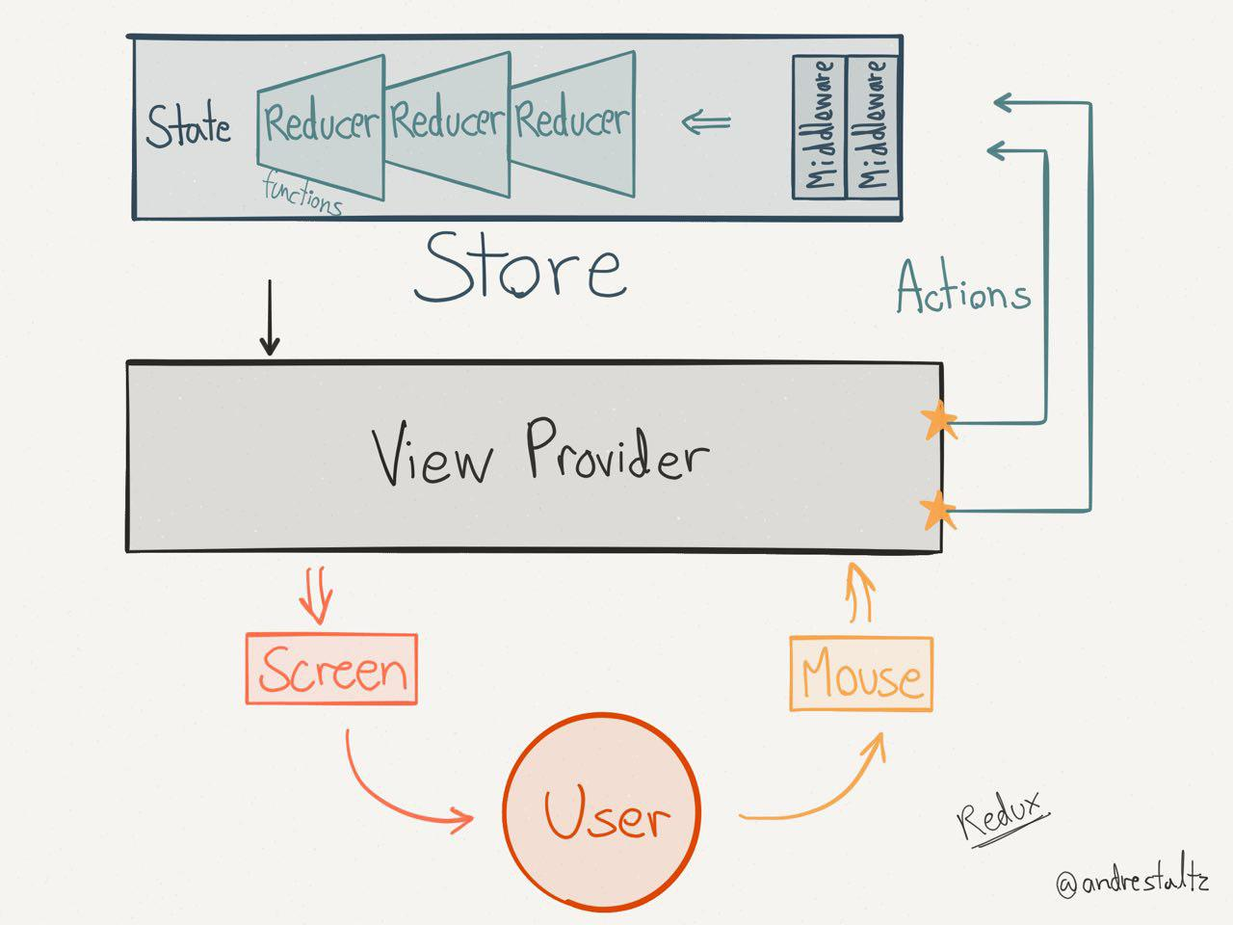
Inspirations
Model
Update
Msg
View (React!)
Check this out!
source

Slide 112
To sum up
Functional programming is used (and useful) in the real world too!
It results in more testable, more reliable, more maintainable code
The design does not control you, You control the design!

Slide 113





Where to go from here?
Pick one (or two!) and start writing
Elm
F#
Scala
Elixir

Slide 114
Thank you and happy (Functional) Programming!

